Slide 1
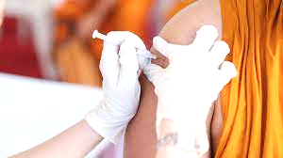
Fundamentals of Nursing(1st Stage)
Part I: 10 Theory-Practice
Administering Intramuscular injections (IM)
University of Basrah –College of Nursing – Fundamentals of Nursing Department

Slide 2
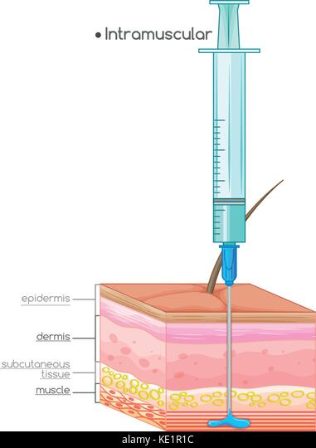
Introduction
An intramuscular (I.M) injection is a procedure used to insert (Drugs or Vaccines)into the muscle tissue.
There is an adequate supply of blood. This facilitates fast absorption, which can lead to better effect.
University of Basrah –College of Nursing– Fundamentals of Nursing Department
2

Slide 3
The speed of absorption is faster for intramuscular injection compared to subcutaneous injection. because the muscle tissue has a greater blood supply than the area just under the skin.
Intramuscular injections should be administered 90 degree angle as possible.
University of Basrah –College of Nursing– Fundamentals of Nursing Department
3

Slide 4
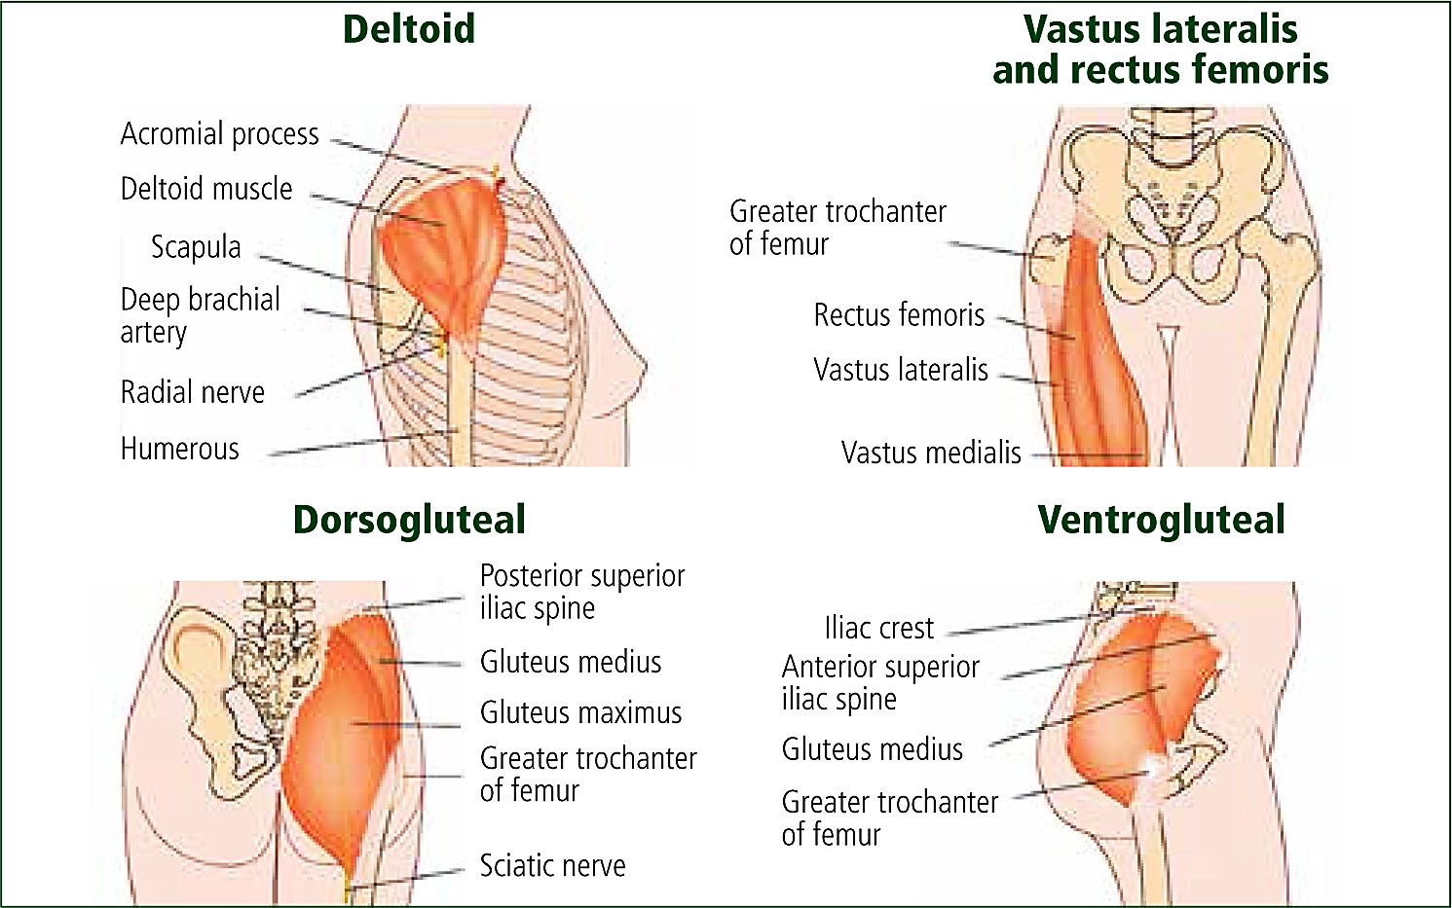
Sites of intramuscular injection
University of Basrah –College of Nursing– Fundamentals of Nursing Department
5

Slide 5
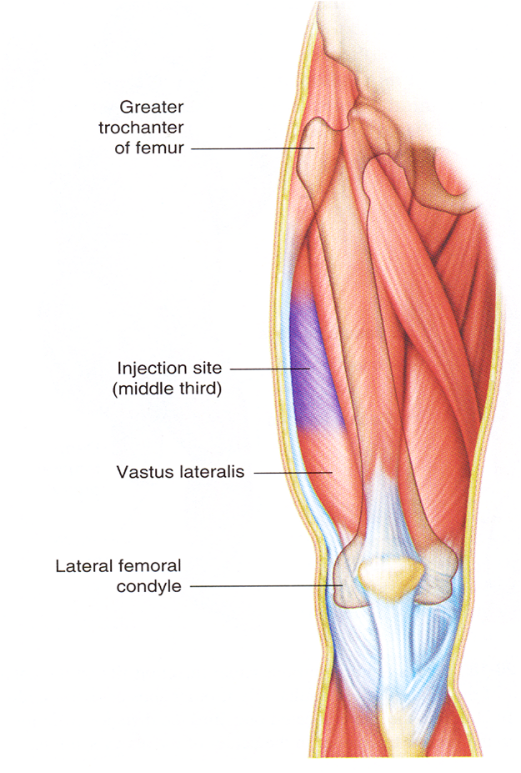
Vastus lateralis muscle
The muscle is thick and well developed.
Used in adult and is preferred site for administration of biologicals (immunizations) to infant.
The middle third of the muscle is the suggested site for injection.
University of Basrah –College of Nursing– Fundamentals of Nursing Department
6

Slide 6
University of Basrah –College of Nursing– Fundamentals of Nursing Department
6

Slide 7
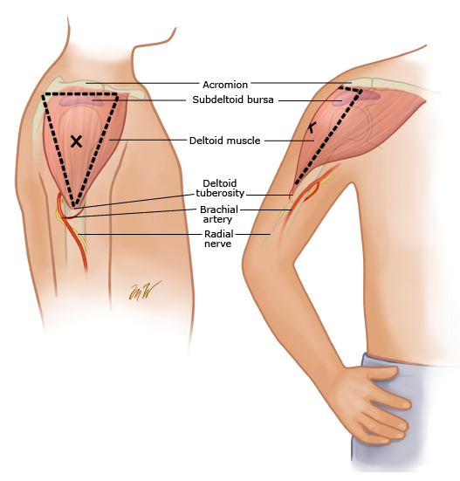
Deltoid muscle
The injection site is in the center of the triangle, about 3 to 5 cm below the acromion process.
This site has a potential for injury because the axillary nerve lies beneath the deltoid
7

Slide 8
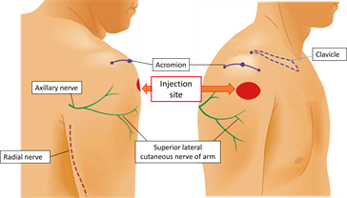
Deltoid muscle
Used for:
small medication volumes (0.5 to 1 ml).
Administration of routine immunization.
When other sites are inaccessible because of dressing.
7

Slide 9
Deltoid muscle
University of Basrah –College of Nursing– Fundamentals of Nursing Department
7

Slide 10
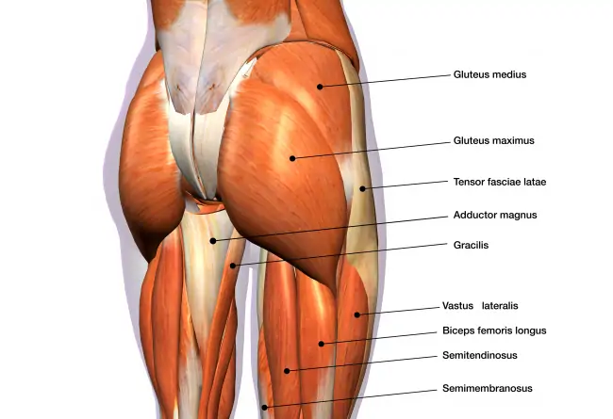
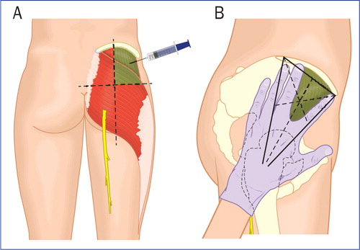
Ventrogluteal muscle
The ventrogluteal muscle involves the gluteus medius and minimus.
It is situated deep and away from major nerves and blood vessels and is a safe for all clients.
University of Basrah –College of Nursing– Fundamentals of Nursing Department
8

Slide 11
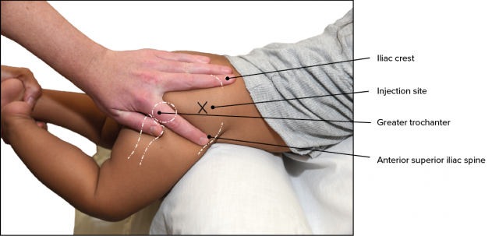
Ventrogluteal muscle
Is a preferred injection site for infants, especially for administration of irritating or oily solutions, children, and adults.
The index finger, the middle finger, and the iliac crest form V-shaped triangle ,and the injection site is the center of the triangle.
University of Basrah –College of Nursing– Fundamentals of Nursing Department
8

Slide 12
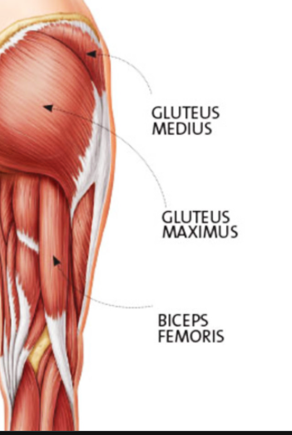
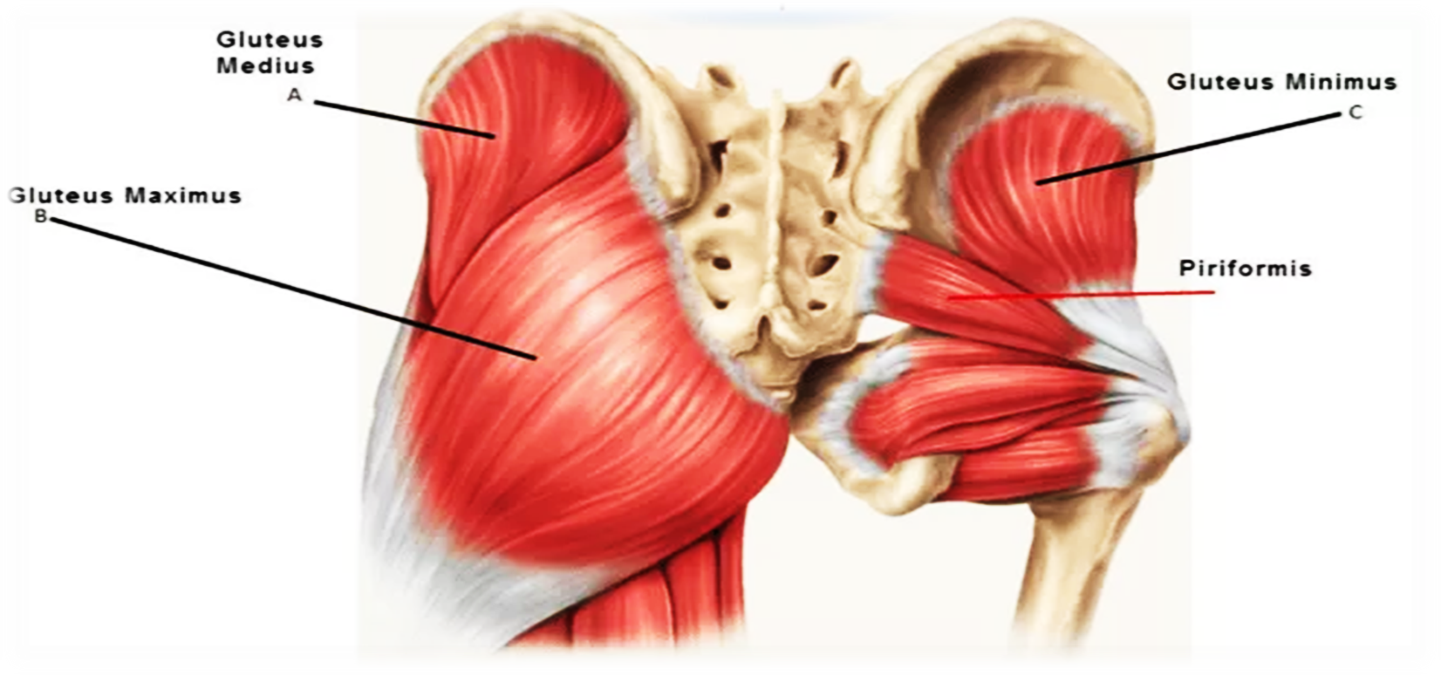
Gluteus medius muscle
University of Basrah –College of Nursing– Fundamentals of Nursing Department
9

Slide 13
Abscess.
Hematoma.
Injury to blood vessels.
Pain at the injection site.
Tingling or numbness.
Infection.
Bleeding.
Allergic reaction.
University of Basrah –College of Nursing– Fundamentals of Nursing Department
10

Slide 14
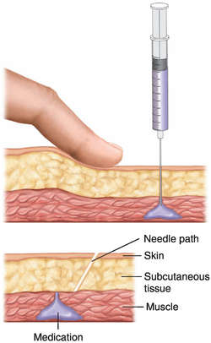
Z –track method
The Z-track method is recommended for I.M injections. The Z-track technique, pulling the skin either downward or laterally before injection. reduces leakage of medication into subcutaneous tissue and minimizes pain.
The nurse selects an I.M site, the overlying skin and subcutaneous tissues are pulled approximately 2.5-3.5 cm down or laterally to the side with the ulnar side of non-dominant hand. The skin is held in this position until the injection has been administered.
University of Basrah –College of Nursing– Fundamentals of Nursing Department
11

Slide 15
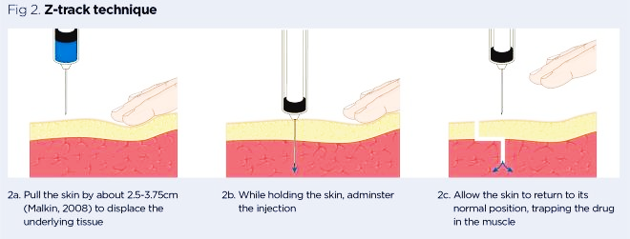
Once the medication is injected, the needle remains inserted for 10 seconds to allow the medication to disperse evenly. The nurse then releases the skin after withdrawing the needle, which leaves a zigzag path that seals the needle track wherever tissue planes slide across each other.
University of Basrah –College of Nursing– Fundamentals of Nursing Department
12

Slide 16
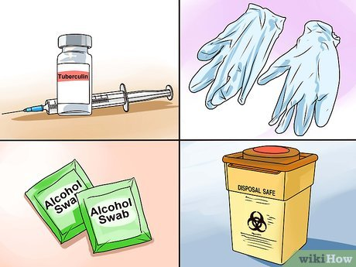
Equipment
Syringe with needle
Alcohol swab
Gauze pad
Medication vial or ampule
Disposable gloves
Medication administration record
University of Basrah –College of Nursing– Fundamentals of Nursing Department
13

Slide 17
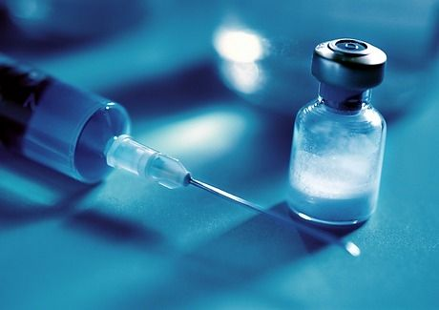
Nursing Diagnoses
Acute pain
Anxiety
Deficient knowledge regarding medication administration or drug therapy
Fear
University of Basrah –College of Nursing– Fundamentals of Nursing Department
14

Slide 18
Implementation
Prepare medications for one patient at a time using aseptic technique.
Close room curtain or door.
Identify patient using two identifiers (i.e., name and birthday or name and account number) according to agency policy.
At patient’s bedside again compare MAR or computer printout with names of medications on medication labels and patient name. Ask patient if he or she has allergies.
Discuss purpose of each medication, action, and possible adverse effects.
Perform hand hygiene and apply clean gloves.
University of Basrah –College of Nursing– Fundamentals of Nursing Department
15

Slide 20
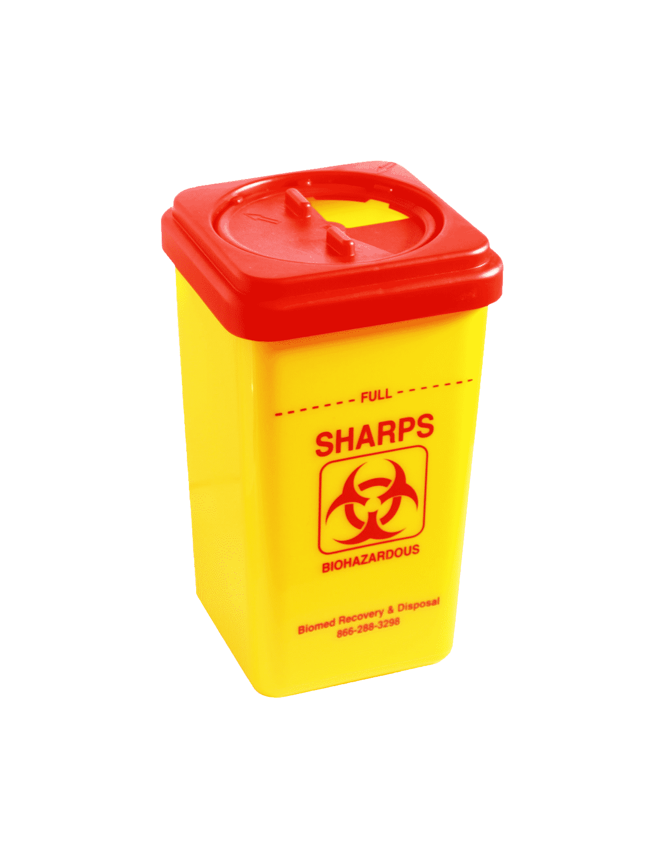
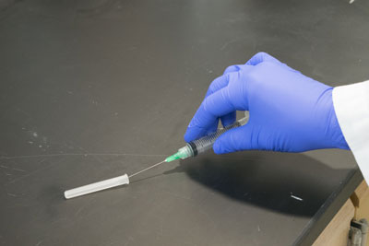
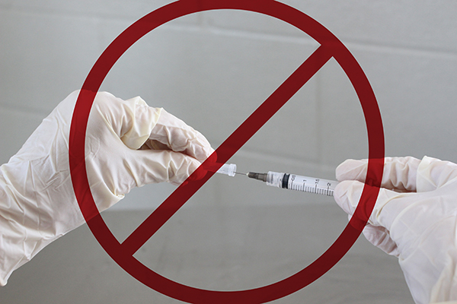
13. Discard uncapped needle or needle enclosed in safety shield and attached syringe into puncture- and leak-proof receptacle.
14. Remove gloves and perform hand hygiene.
University of Basrah –College of Nursing– Fundamentals of Nursing Department
18

Slide 21
University of Basrah –College of Nursing– Fundamentals of Nursing Department
19

